Slide 1

Spring-2021
(Week-1)
Data Communication & Networks
Course Teachers: Mr. Waleej Haider (Asst. Prof),
MS Razia Nisar noorani (Asst. Prof)
Department of Computer Science & Information Technology

Slide 2
Blended Mode of Teaching
The aim is to follow guidelines of authorities for the implementation of SOPs.
Self learning using provided material
Assessment of the students
On-campus teaching
Assessment methods/modes
Attendance modes

Slide 3
Course Information Sheet (CIS)
Two Parts:
1. Data Communication
2. Computer Networks

Slide 4
Chapter 1. Introduction
Data communications
Networks
Network Performance Criteria
Types of Connections
Copy rights: Waleej Haider

Slide 5
1. Data Communications
Data
Information presented in whatever form, agreed upon by the parties who are creating and using the data
Communication
Sharing information
Sharing can be local or remote
Local Communication: usually occurs face to face
Remote communication: takes place over distance (prime concern)
Data Communication
Exchange (sharing) of data between two devices
Via some form of transmission medium (wired or wireless)
Under some protocols
Communication System includes:
Hardware : Physical equipment/devices
Software : Programs
Copy rights: Waleej Haider

Slide 6
Cont..
Fundamental characteristics of effective data communication
The effectiveness of a data Comm. System depends on 4 fundamental chars.:
Delivery: Delivery of data to the correct and only that destination
Accuracy: No loss of information/data
Timeliness: Without significant delay & in the same order (audio/video)
Jitter : Variation in the packet arrival time (uneven delay)
Telecommunication:
Communication at a distance (‘tele’ in Greek means “far”)
using telephony, telegraphy, television, computer.
See Notes Below to understand the concept.
Notes:
1. Delivery. The system must deliver data to the correct destination. Data must be received by the intended device or user and only by that device or user. 2. Accuracy. The system must deliver the data accurately. Data that have been altered in transmission and left uncorrected are unusable. 3. Timeliness. The system must deliver data in a timely manner. Data delivered late are useless. In the case of video and audio, timely delivery means delivering data as they are produced, in the same order that they are produced, and without significant delay. This kind of delivery is called real-time transmission. 4. Jitter. Jitter refers to the variation in the packet arrival time. It is the uneven delay in the delivery of audio or video packets. For example, let us assume that video packets are sent every 3D ms. If some of the packets arrive with 3D-ms delay and others with 4D-ms delay, an uneven quality in the video is the result.
<number>

Slide 7
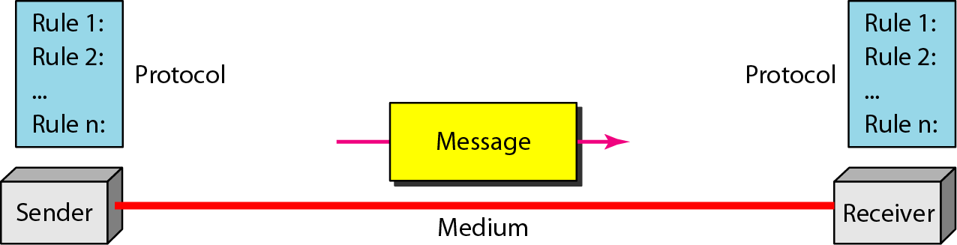
Five Components of Data Communication
Message: Information (data) to be communicated (text, numbers, pics, audio, video)
Sender: that sends the data message
Receiver: that receives the message
Transmission medium: Physical path by which a message travels
Protocol: A set of rules that govern data communication. An agreement between the communicating devices. Without a protocol, two devices may be connected but not communicated
See Notes Below to understand the concept.
Copy rights: Waleej Haider
Notes:
1. Message. The message is the information (data) to be communicated. Popular forms of information include text, numbers, pictures, audio, and video. 2. Sender. The sender is the device that sends the data message. It can be a computer, workstation, telephone handset, video camera, and so on. 3. Receiver. The receiver is the device that receives the message. It can be a computer, workstation, telephone handset, television, and so on. 4. Transmission medium. The transmission medium is the physical path by which a message travels from sender to receiver. Some examples of transmission media include twisted-pair wire, coaxial cable, fiber-optic cable, and radio waves. 5. Protocol. A protocol is a set of rules that govern data communications. It represents an agreement between the communicating devices. Without a protocol, two devices may be connected but not communicating, just as a person speaking French cannot be understood by a person who speaks only Japanese.
<number>

Slide 8
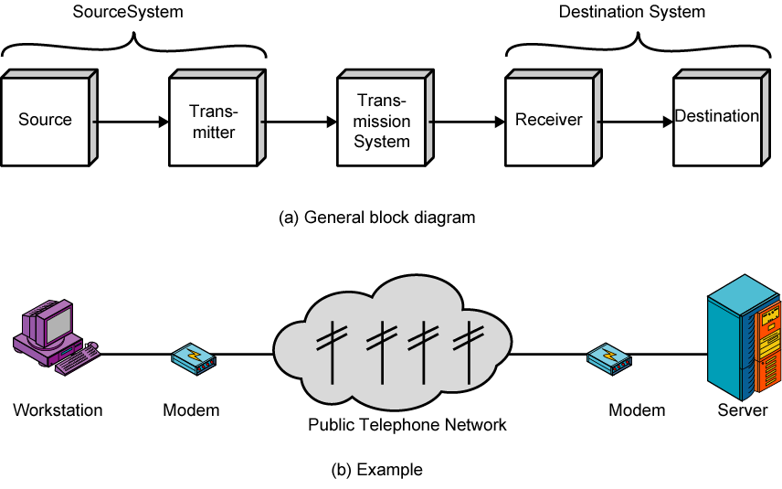
A Communication Model
(Digital bits to analog signals)
(Analog signals to Digital bits)
Notes:
<number>
The fundamental purpose of a communications system is the exchange of data between two parties. This section introduces a simple model of communication, illustrated in general and by specific example in Stallings DCC8e Figure 1.2. The key elements of this model are:
Source - generates data to be transmitted
Transmitter - converts data into transmittable signals
Transmission System - carries data from source to destination
Receiver - converts received signal into data
Destination - takes incoming data

Slide 9
Cont..
Source - generates data to be transmitted
Transmitter - converts data into transmittable signals
Transmission System - carries data from source to destination
Receiver - converts received signals into data
Destination - takes incoming data

Slide 10
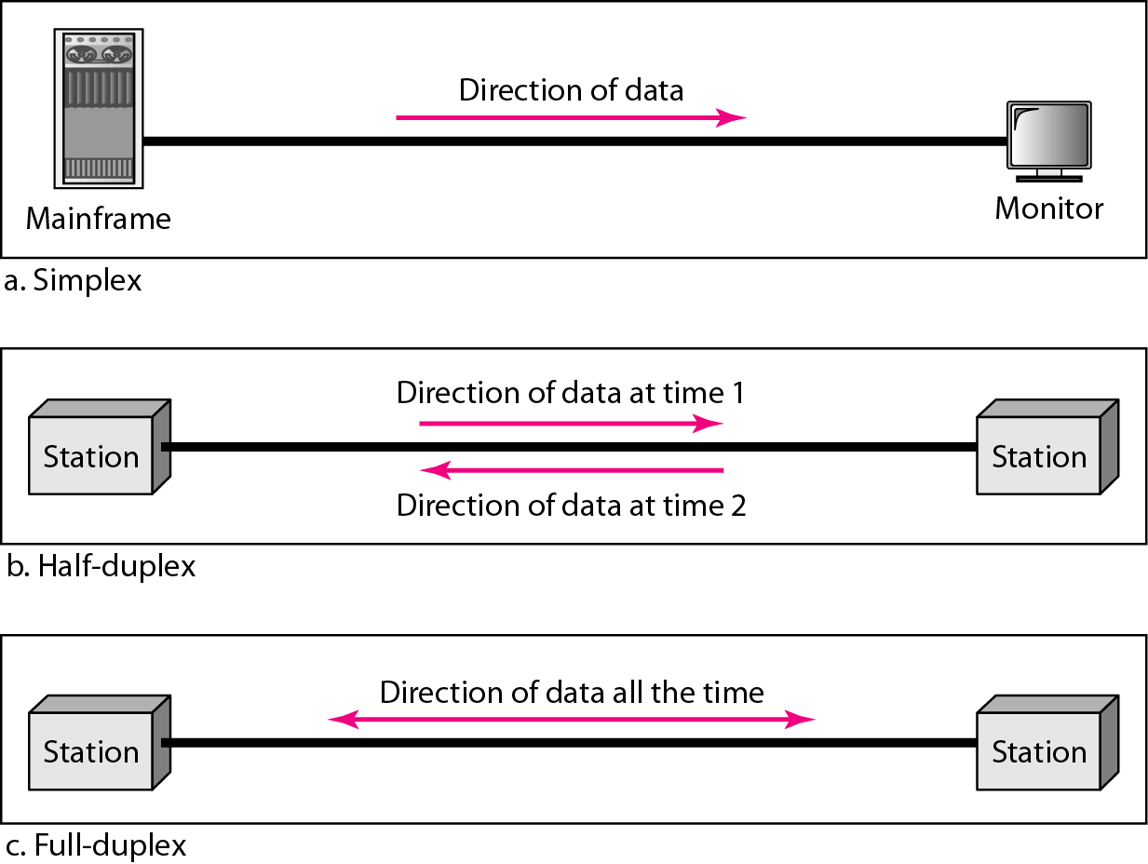
Direction of Data Flow
See Notes, below to understand the concept.
Notes:
Simplex In simplex mode, the communication is unidirectional, as on a one-way street. Only one of the two devices on a link can transmit; the other can only receive (see Figure 1.2a). Keyboards and traditional monitors are examples of simplex devices. The keyboard can only introduce input; the monitor can only accept output. The simplex mode can use the entire capacity of the channel to send data in one direction. Half-Duplex In half-duplex mode, each station can both transmit and receive, but not at the same time. : When one device is sending, the other can only receive, and vice versa (see Figure b.
The half-duplex mode is like a one-lane road with traffic allowed in both directions. When cars are traveling in one direction, cars going the other way must wait. In a half-duplex transmission, the entire capacity of a channel is taken over by whichever of the two devices is transmitting at the time. Walkie-talkies and CB (citizens band) radios are both half-duplex systems. The half-duplex mode is used in cases where there is no need for communication in both directions at the same time; the entire capacity of the channel can be utilized for each direction Full-Duplex In full-duplex mode (also called duplex), both stations can transmit and receive simultaneously (see Figure c). The full-duplex mode is like a two-way street with traffic flowing in both directions at the same time. In full-duplex mode, signals going in one direction share the capacity of the link: with signals going in the other direction. This sharing can occur in two ways: Either the link must contain two physically separate t:nmsmissiIDn paths, one for sending and the other for receiving; or the capacity of the ch:annel is divided between signals traveling in both directions. One common example of full-duplex communication is the telephone network. When two people are communicating by a telephone line, both can talk and listen at the same time. The full-duplex mode is used when communication in both directions is required all the time. The capacity of the channel, however, must be divided between the two directions.
<number>

Slide 11
Data Flow
Simplex
Unidirectional
As on a one-way street
Half-duplex
Both transmit and receive possible, but not at the same time
When there is no need for communication in both direction at the same time
Like a one-lane road with two-directional traffic but at different times
Entire capacity of the channel can be utilized for each direction
Walkie-talkie, CB (citizens band) radio
Full-duplex
Transmit and receive simultaneously
Like a two-way street; telephone network
Channel capacity must be divided between two directions

Slide 12
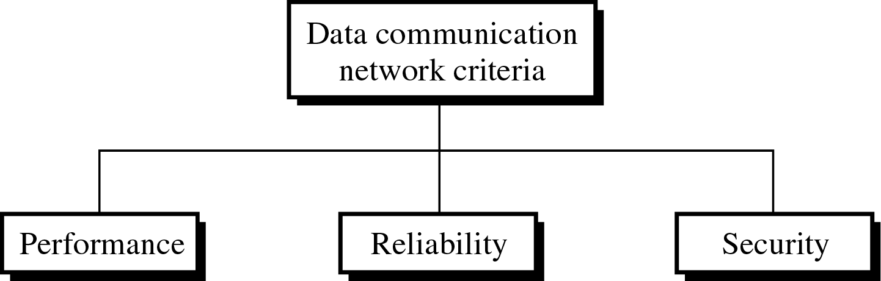
2. Networks
Network: A set of devices (nodes) connected by communication links
Node: Computer, printer, or any device capable of sending and/or receiving data
Network Criteria: To be considered effective and efficient, a network must meet a number of criteria
Most networks use distributed processing, in which a task is divided among multiple computers. Instead of one single large machine being responsible for all aspects of a process, separate computers (usually a personal computer or workstation) handle a subset.

Slide 13
Network Criteria
Performance can be measured in:
Transit time: amount of time required for a message to travel from one device to another
Response time: elapsed time between an inquiry and a response
More throughput (no. of bits/sec)
Less delay
Other factors: no. of users, type of medium, connected hardware, and efficiency of the software
See Notes, below to understand the concept.
Notes:
Performance Performance can be measured in many ways, including transit time and response time. Transit time is the amount of time required for a message to travel from one device to another. Response time is the elapsed time between an inquiry and a response. The performance of a network depends on a number of factors, including the number of users, the type of transmission medium, the capabilities of the connected hardware, and the efficiency of the software. Performance is often evaluated by two networking metrics: throughput and delay. We often need more throughput and less delay. However, these two criteria are often contradictory. If we try to send more data to the network, we may increase throughput but we increase the delay because of traffic congestion in the network. Reliability In addition to accuracy of delivery, network reliability is measured by the frequency of failure, the time it takes a link to recover from a failure, and the network's robustness in a catastrophe. Security Network security issues include protecting data from unauthorized access, protecting data from damage and development, and implementing policies and procedures for recovery from breaches and data losses.
<number>

Slide 14
Cont..
Reliability is measured by:
Frequency of link failure
Recovery time from a failure
Network robustness in a crash
Security issues include:
Protecting data from unauthorized access
Protecting data from damage
Implementing policies for recovery from data losses

Slide 15
Task-1:
Write a summary of the following topics:
Direction of flow
Network Criteria
------------------------------------------------------------------------------------------------------------------------------------------------------------------------------------------------------------------------------------------------------------------------------------------------------------------------------------------------------------------------------------------------------------------------------------------------------------------------------

Slide 16
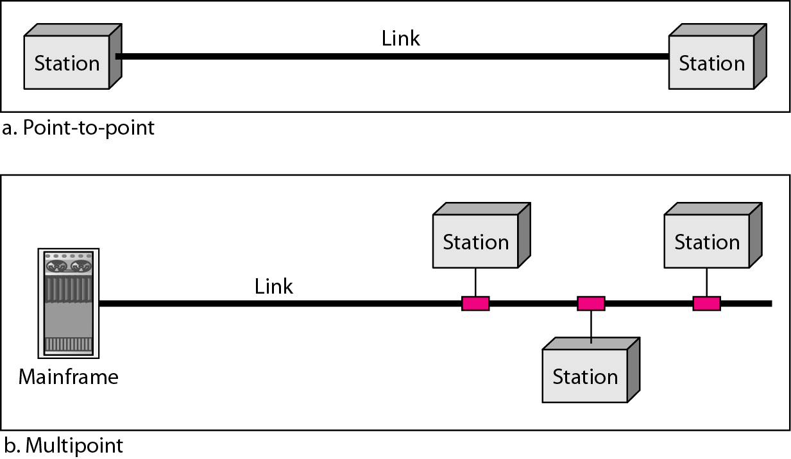
Type of Connection
See Notes, below to understand the concept.
Notes:
Type of Connection A network is two or more devices connected through links. A link is a communications pathway that transfers data from one device to another. For visualization purposes, it is simplest to imagine any link as a line drawn between two points. For communication to occur, two devices must be connected in some way to the same link at the same time. There are two possible types of connections: point-to-point and multipoint. Point-to-Point A point-to-point connection provides a dedicated link between two devices. The entire capacity of the link is reserved for transmission between those two devices. Most point-to-point connections use an actual length of wire or cable to connect the two ends, but other options, such as microwave or satellite links, are also possible (see Figure a). When you change television channels by infrared remote control, you are establishing a point-to-point connection between the remote control and the television's control system. Multipoint A multipoint (also called multidrop) connection is one in which more than two specific devices share a single link (see Figure b). In a multipoint environment, the capacity of the channel is shared, either spatially or temporally. If several devices can use the link simultaneously, it is a spatially shared connection. If users must take turns, it is a timeshared connection.
<number>

Slide 17
Types of Connection
Point-to-point
Dedicated link between two devices
The entire capacity of the channel is reserved
Wired or wireless
Eg: Microwave or satellite link, link between TV and remote control
Multipoint
More than two devices share a single link
Capacity of the channel is shared either
Spatially shared: Several devices can use the link simultaneously (cable TV channels using diff freq. bandwidths)
Temporally shared: Users must take their turns, also called timeshared (telephone networks)

Slide 18
NOTE:
Prepare a list questions to be answered in the class
Be Prepared for a short quiz from the above topics

